Slide 1

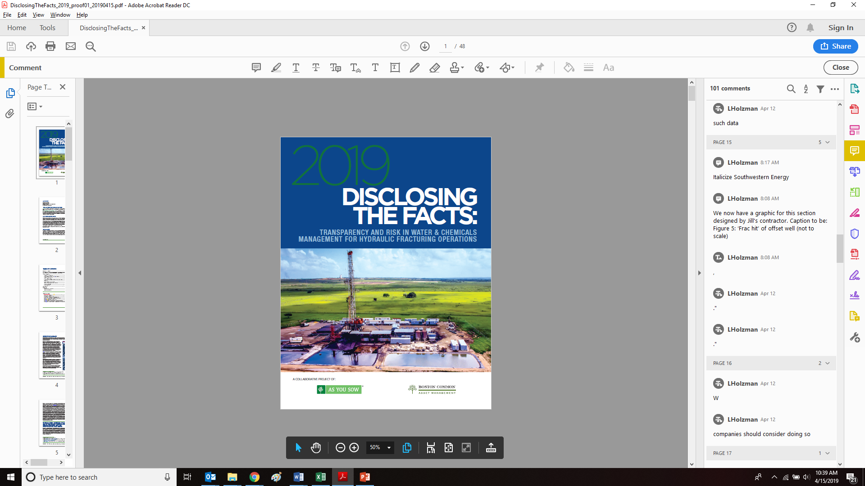
The Current State of Water & Chemicals Reporting for Hydraulic Fracturing Operations
Findings from:
Disclosing the Facts 2019:
Transparency and Risk in Water & Chemicals Management for
Hydraulic Fracturing Operations
Download the report at http://disclosingthefacts.org/

Slide 2




Featured Speakers
Danielle Fugere
As You Sow
Steven Heim
Boston Common
Asset Management,
LLC
Richard Liroff Senior Advisor
Lila Holzman
As You Sow
April 25, 2019

Slide 3
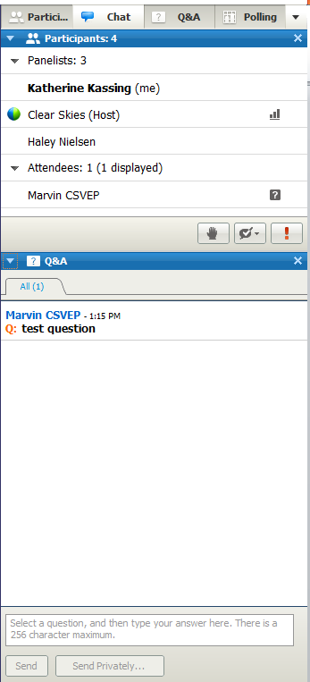
Audience Q & A
Download the report at http://disclosingthefacts.org/
Use the Q&A window to send us your questions
Q&A Window

Slide 4
Richard Liroff
Senior Advisor

Slide 5
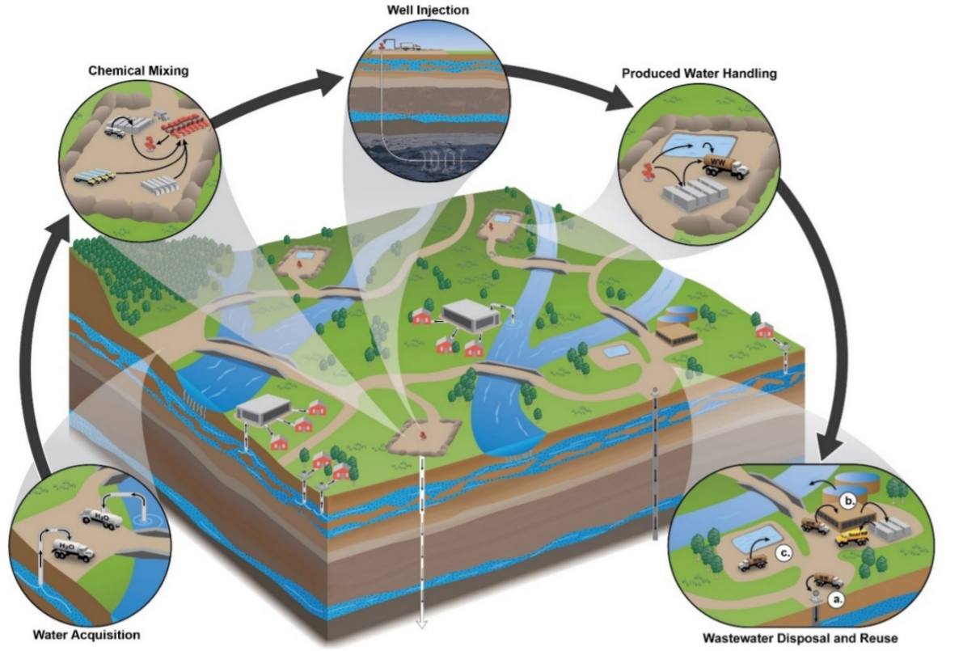
Water & Chemicals – Why Investors Care
Hydraulically fractured wells = 69% of all new wells drilled in the US.
128,000 wells fractured since 2011
Water and chemical concerns:
  Water availability
  Wastewater disposal/reuse
  Chemical disclosure/toxicity
Needed: rigorous, relevant, timely, comparable data about practices and outcomes

Slide 6
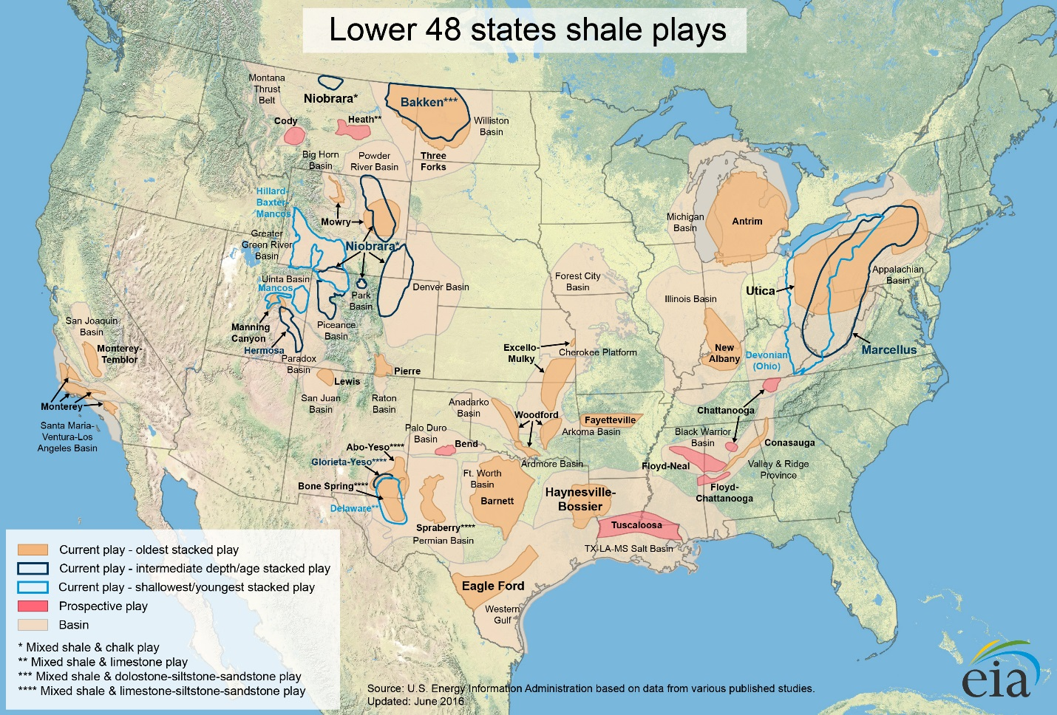
128,000 wells fractured since 2011

Slide 7
Disclosing the Facts 2019 - Methodology
30 Oil & Gas companies reviewed
Process: Adapted/Crafted questions; Company feedback via conference call; Shared draft scores; One-on-One calls as requested; Final scoring
25 questions/KPIs demonstrate systematic water and chemicals management
The information in this report should not be considered a recommendation to buy or sell any security. All investments involve risk, including the risk of losing principal.

Slide 8
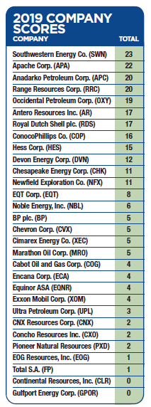
Disclosing the Facts 2019 - Scores
Leaders:
  Southwestern Energy (23)
  Apache (22)
  Anadarko (20)
  Range Resources (20)
  Occidental Petroleum (19)
Laggards:
  Gulfport Energy, Continental Resources (0)
  Total, EOG Resources (1)
  Pioneer Resources, Concho Resources, CNX Resources (2)
The information in this report should not be considered a recommendation to buy or sell any security. All investments involve risk, including the risk of losing principal.

Slide 9
Disclosing the Facts 2019 – Disclosure Tallies
Most frequent disclosures:
  Near misses/close calls (21)
  CBI disclaimer—not all chemicals disclosed (17)
  Well integrity practices (16)
Least frequent disclosures:
  Pre-drilling water quality monitoring (1)
  Post-drilling water quality monitoring (3)
  Quantitative reductions in chemical toxicity (3)
The information in this report should not be considered a recommendation to buy or sell any security. All investments involve risk, including the risk of losing principal.

Slide 10
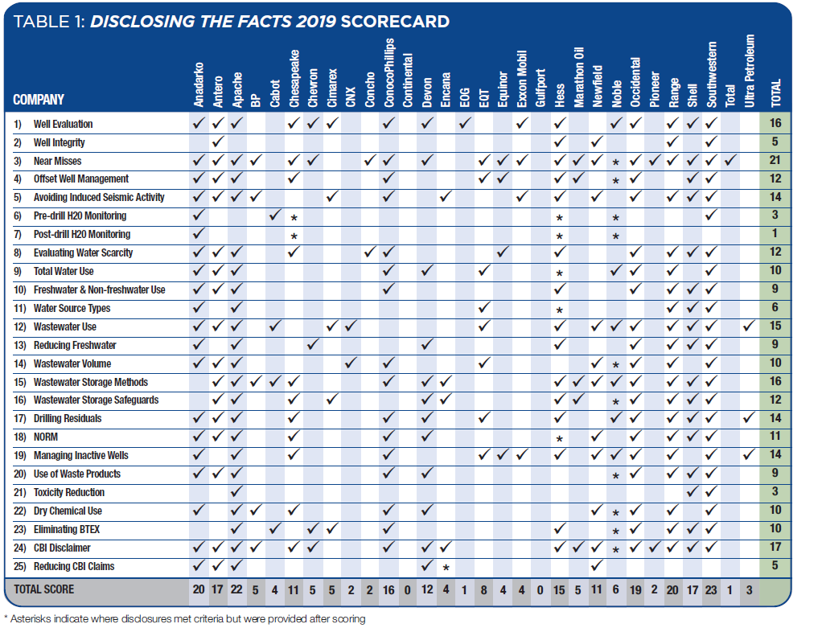
Disclosing the Facts 2019 – Disclosure Overview
The information in this report should not be considered a recommendation to buy or sell any security. All investments involve risk, including the risk of losing principal.

Slide 11
Danielle Fugere
As You Sow

Slide 12
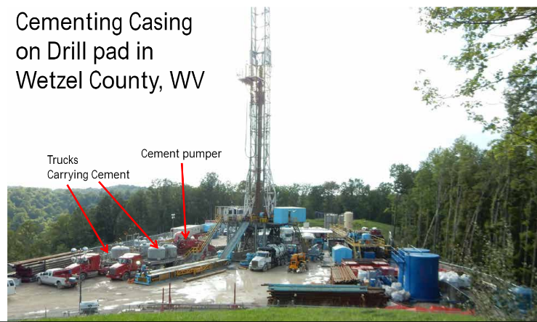
Preventing Well Integrity Failures
Q: Practices to maintain and monitor for well
integrity post completion
Q: % of wells experiencing well integrity
failure resulting in a release to environment
Why does it matter?
Well integrity failures can occur due to flawed design or construction, poor cementing, human error, corrosive substances, formation stresses, changes in temp and pressure
Consistent monitoring ensures that any leaks are fixed quickly and potential contamination of nearby water sources is prevented or minimized.
Not all spills reach the environment, knowing how many do is important

Slide 13
Preventing Well Integrity Failures
Notable Practices:
One company uses multiple practices: ultrasonic testing of pipe thickness, remote & local emergency shut down systems, pressure testing, flow velocity measurements, annulus press monitoring, acoustic logs, and SCADA systems for remote surveillance.
Disclosure of public complaints about potential releases and investigations
Some companies employ continuous monitoring systems
Disclosures:
Sixteen companies disclosed well integrity practices
Five companies reported well integrity failures reaching environment

Slide 14
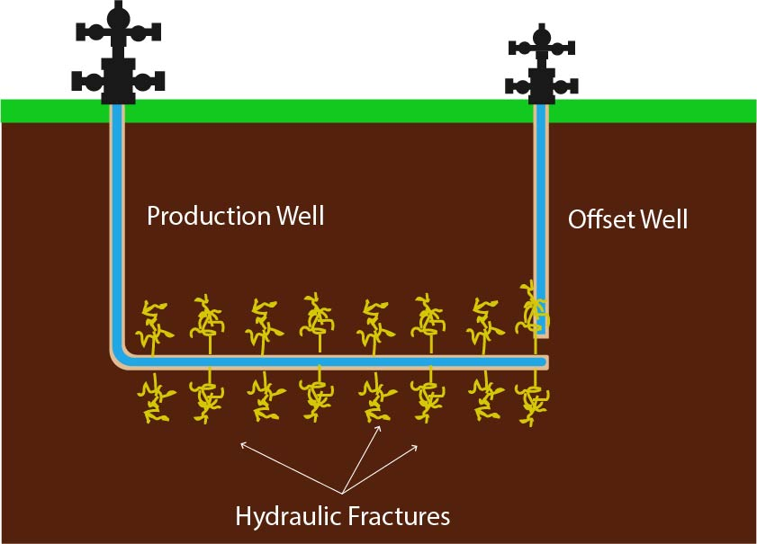
Managing Risks from Nearby Wells, Faults, and Fractures
Q: What steps are taken, when planning to drill and complete new wells, to minimize risk from nearby wells, faults, & fractures
Why does it matter?
Nearby offset oil and gas wells can provide pathways for fracturing fluids, hydrocarbons & other contaminants to enter the environment
High pressure can damage
nearby wells
Fractures intersecting
an existing operating well
can lower productivity

Slide 15
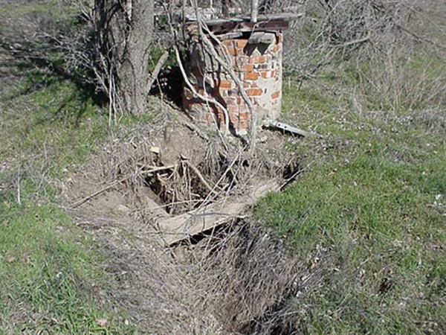
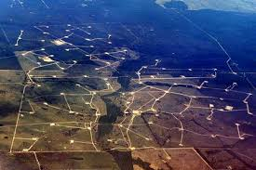
Managing Risks from Nearby Wells, Faults, and Fractures
Notable Practices:
At least one company remediates or plugs existing
abandoned wells that do not meet integrity
standards
Some companies assess impact for wells located
beyond minimum regulatory requirements
Disclosures:
Twelve companies disclosed risk reduction
measures to avoid intersecting nearby wells, faults & fractures

Slide 16

Monitoring Water Quality Before and After Drilling and Completions
Q: Do companies disclose pre- and post-drilling water quality monitoring practices on a play-by-play basis, including frequency
and constituents tested
Why does it matter?
Pre-drill water quality testing can set a
baseline for water quality prior to drilling
Post-drill testing can help demonstrate no
impacts from drilling, or identify issues
Continued post-drill testing ensures any
potential leaks are identified

Slide 17
Monitoring Water Quality Before and After Drilling and Completions
Notable Practices:
Companies provide a range of testing related information. Some describe types of water sources monitored, distances from wellbore, some mention chemicals measured, some identify plays where testing occurs, most however lack specificity on frequency and constituents
Disclosures:
Three companies disclose their pre-drill monitoring practices
One company earned credit for disclosing post-drill monitoring

Slide 18
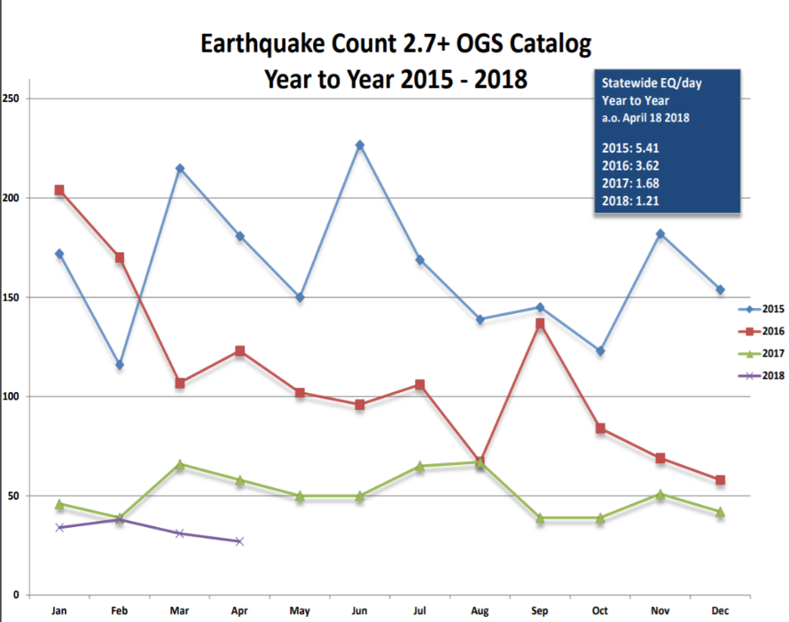
Minimizing Induced Seismicity
Q: Do companies disclose the steps they take to identify and avoid inducing seismic activity that can be felt on the earth’s surface
Why does it matter?
As hydraulic fracturing has
increased, so have earthquakes,
primarily from deep well injection
Oklahoma earthquakes:
2008 - 2 magnitude 3.0 or > quakes;
2015, 903 magnitude 3.0 or > quakes

Slide 19
Minimizing Induced Seismicity
Notable Practices:
Companies avoid siting disposal wells in seismically sensitive areas
Companies deploy an extensive array of seismicity monitors and implement contingency plans where seismic activity indicated
Companies monitor 3rd party waste contractors to ensure safe
wastewater handling
Disclosure:
14 companies disclosed seismicity management measures, including from disposal of waste water in injection and risks from drilling and completing new production wells.

Slide 20
Steven Heim
Boston Common
Asset Management, LLC

Slide 21
Reducing Chemical Hazards
Q: Does the company report quantitatively on toxic chemical use reduction, including indicating a baseline year?
Q: Does the company state a practice to use dry hydraulic fracturing chemicals instead of liquid ones, and in what circumstances?
Q: Does the company state a practice to not use benzene, toluene, ethylbenzene and xylene (BTEX) in hydraulic fracturing fluids?
Q: If a company excludes reporting of chemicals due to claims of confidential business information (CBI), does the company clearly state on its website that FracFocus and/or its reporting may exclude chemicals protected by claims of CBI?
Q: Does the company state measures it and/or its third-party contractors take to reduce CBI claims for chemicals used in its hydraulic fracturing operations?

Slide 22
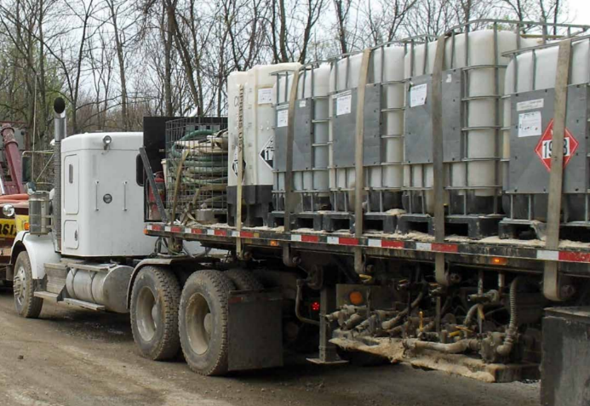
Reducing Chemical Hazards
Why It Matters:
Chemicals use is a key concern due to potential water risks, but few report on progress in reducing toxicity
Transporting dry chemicals to well sites reduces risks from surface spills of liquid chemicals
Twenty-four states require some form of chemical disclosure, 20 of them allow or require the use of FracFocus

Slide 23
Reducing Chemical Hazards
Notable Practices:
Using own scoring system to assess environmental and health hazards from chemicals selected for drilling and completion
Transporting dry or powdered chemicals to then mix at well sites, instead of transporting liquid chemicals
Disclosures:
Three companies reported quantitatively their progress in toxicity reduction
Ten reported on use of dry chemicals
Ten disclosed their policies to eliminate BTEX
Seventeen disclosed that the identity of some chemicals used is not on FracFocus
Five detailed efforts to cut trade secrecy claims

Slide 24
Sourcing Water
For each play, does company report:
Q: whether play is located in a water scarce area and criteria
for whether an area is 'water scarce'?
Q: aggregate quantity of water used for operations?
Q: percentage of water sourced from freshwater vs. non-freshwater resources?
Q: percentage of water sourced from specific location types (e.g., groundwater, surface water, municipal, water, recycled, etc.)?
Q: the percentage of produced and/or flowback water reused?
Q: practices for reducing use of fresh water in operations?

Slide 25
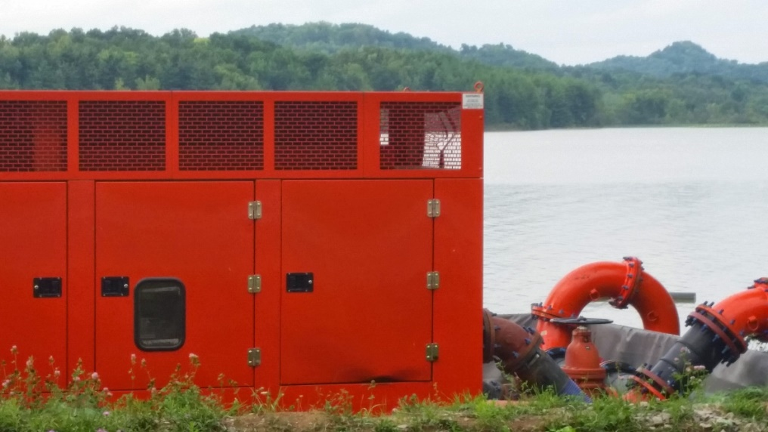
Sourcing Water
Why It Matters:
Companies are using more water per well in many plays than in the past, some in arid regions
And… they are using less fresh water and more brackish or recycled water, enabled by new fracturing chemicals
Reusing produced water saves money, conserves valuable resource, and cuts seismic risks from deep well disposal

Slide 26
Sourcing Water
Notable Practices:
“Water neutral”… replacing every gallon of fresh water in same region
Reporting high % use of recycled waste water or nonpotable water
Dedicated wastewater treatment facilities to reuse wastewater
Detailed info on water planning, sourcing, & management practices
Disclosures:
Eight companies disclosed practices to cut fresh water
Nine reported % fresh vs. non fresh sources
Six disclosed % water sources from specific types
Fifteen reported % waste water reused for well completions

Slide 27
Lila Holzman
As You Sow

Slide 28
Sourcing Water
Storing Wastewater and Drilling Wastes
For Each Play Does Company Report:
Q: Total volume of wastewater generated at its well-heads?
Q: Methods used to store produced water (i.e., tanks, open impoundments) in each play?
Q: Measures to reduce spills, leaks, volatile emissions, and/or hazards to wildlife?
Q: Management practices for post-drilling residuals, including residuals that contain oily wastes or other toxic or hazardous materials?

Slide 29
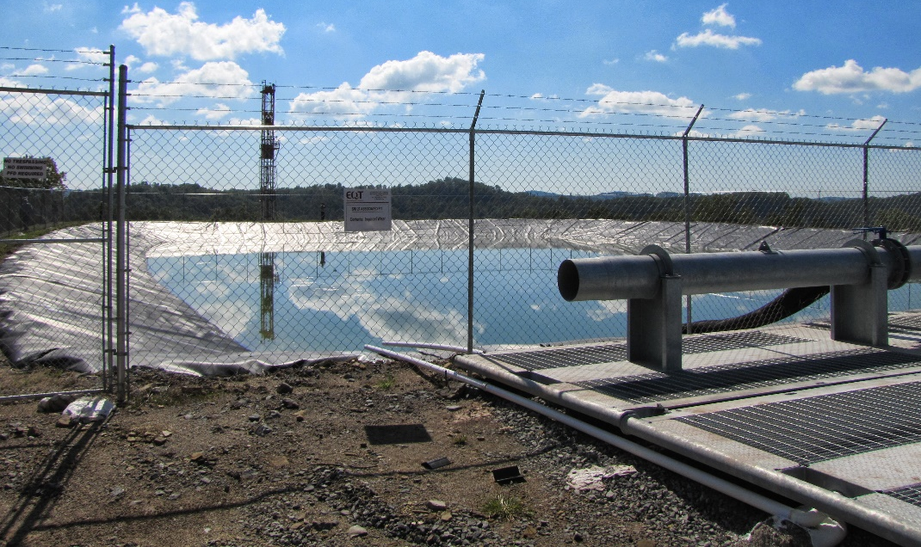
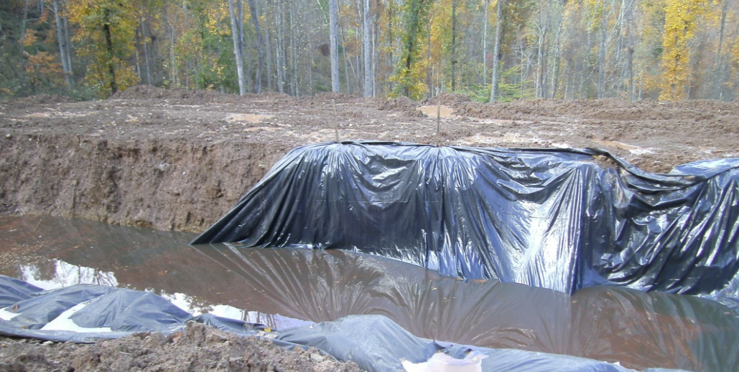
Storing Wastewater and Drilling Wastes
Why it Matters:
Wastewater generation in the Permian will double by 2022: Major capacity constraint that could result in increased costs and lost production.
Wastewater can result in contamination from: pipeline leaks, equipment failures, overflow of pits, road hazards during transport.

Slide 30
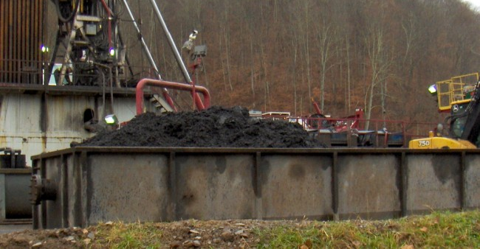
Storing Wastewater and Drilling Wastes
Notable Practices:
Best practices can prevent spillage of wastewater: maintain liners, berms, leak detection equipment; use of tanks.
Solid waste (drill cuttings & mud) also require proper disposal methods. Closed-loop systems with recycling are a best practice.
Disclosures:
Ten companies earned credit for disclosing the total volume of wastewater generated per play.
Sixteen companies disclosed which wastewater storage methods they use.
Twelve described practices are used to protect the environment for each method.
Fourteen earned credit for disclosing
practices for managing drilling waste.

Slide 31
Applying Treated Wastewater to Roads and Crops
Q: If waste products from operations are reused for purposes other than hydraulic fracturing operations, how are such waste products used (e.g., wastewater for dust suppression or agricultural irrigation or road de-icing) and methods for assuring such measures do not cause human or environmental harm?
Why it Matters:
This is an emerging issue; Research is needed to understand impacts and safety concerns.
Controversies involving conventional oil & gas wastewater reuse have reduced public acceptance of such practices:
  PA: Used on roads to deice or suppress dust. Concerns regarding runoff & leaching. DEP recently stopped allowing.
  CA: Used to irrigate crops. Concerns about disposal into aquifers and about use of hydraulic fracturing wastewater.
Disclosures:
9 companies disclosed practices for reusing wastewater for road or other such uses, or that wastewater is not reused for such purposes.

Slide 32
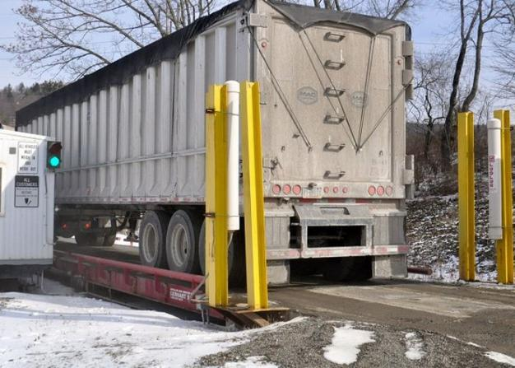
Managing Radiation Risks
Q: Does company report practices for identifying and managing hazards from naturally occurring radioactive materials (NORM), including contaminated equipment and wastewater, and for tracking its own and its contractors’ management of such wastes?
Why it Matters:
Naturally Occurring Radioactive Materials (NORM) can be brought to the surface in produced water and drilling waste.
NORM can negatively impact human health and the environment if mismanaged.
Notable Practices:
Tracking and disposing NORM materials
at sites licensed to manage such
radioactive waste appropriately.
Training staff to handle carefully.
Disclosures:
11 companies disclosed practices for
managing NORM material.

Slide 33
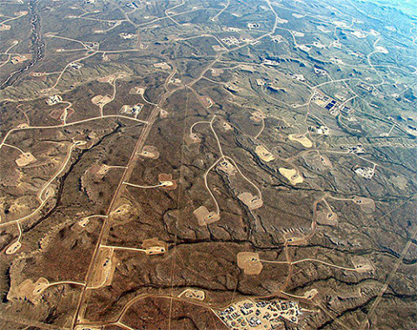
Managing Inactive Wells
Q: Does company explain process for managing inactive wells, including whether practice differs from play to play?
Why it Matters:
In Alberta, the number of inactive wells is expected to double to 180,000 by 2030. Cleanup could cost billions.
While some inactive wells may be used again, some are not.
Plugged wells have been found to leak, and plug technologies vary. Further research is needed to determine the best options for different types of wells.
Notable Practices:
Practices vary to ensure proper closure of
inactive wells. Steps include: plugging, removing
equipment, restoring/remediating land to prior
conditions.
Disclosures:
14 companies described practices used
companywide for closing wells.

Slide 34
Disclosing the Facts 2019 - Trends
Substantial improvements since 2013
Investor/company engagement learnings
Other detailed disclosure initiatives:
  Natural Gas Supply Collaborative
  “Responsible Gas” certification
Despite improvements since 2013, a significant portion of the industry is leaving investors substantially in the dark.
The information in this report should not be considered a recommendation to buy or sell any security. All investments involve risk, including the risk of losing principal.

Slide 35
Audience Q & A
Download the report at http://disclosingthefacts.org/
Use the Q&A window to send us your questions
Q&A Window

Slide 36
Featured Speakers
Danielle Fugere
As You Sow
Steven Heim
Boston Common
Asset Management,
LLC
Richard Liroff Senior Advisor
Lila Holzman
As You Sow
April 25, 2019

Slide 37
Authors
Danielle Fugere, As You Sow
dfugere@asyousow.org
Steven Heim, Boston Common Asset Management, LLC
sheim@bostoncommonasset.com
Lila Holzman, As You Sow
lholzman@asyousow.org
Richard Liroff, Senior Advisor
Benjamin Davis, As You Sow Consultant

Slide 38
Contact
Media/Press Contact
Stefanie Spear: (216) 387-1609
sspear@asyousow.org
For Follow Up Questions, Contact
Lila Holzman:
lholzman@asyousow.org
Download the report at http://disclosingthefacts.org/

